Slide 1
Relationships within the Relational Database
Module 7
Prepared by: Engr. Ryan D. Francisco

Slide 2
Relationships within the Relational Database
1:M relationship
Relational modeling ideal
Should be the norm in any relational database design
1:1 relationship
Should be rare in any relational database design

Slide 3
Relationships within the Relational Database (cont’d.)
M:N relationships
Cannot be implemented as such in the relational model
M:N relationships can be changed into 1:M relationships

Slide 4
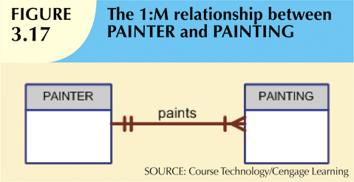
The 1:M Relationship
Relational database norm
Found in any database environment

Slide 5
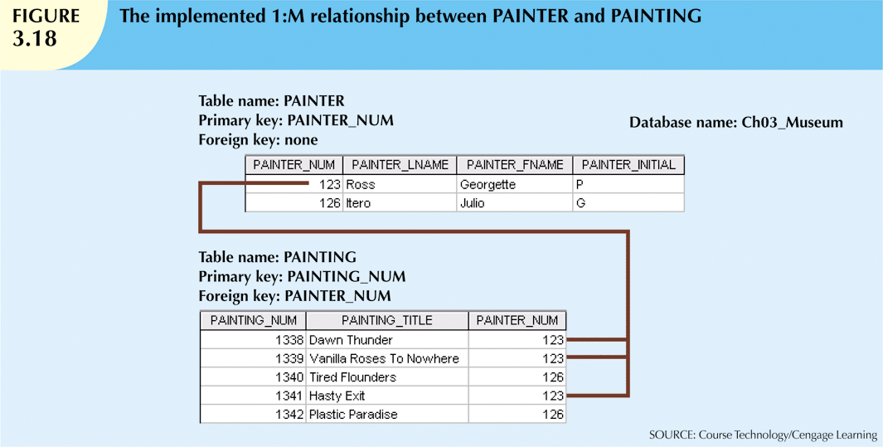

Slide 6
The 1:1 Relationship
One entity related to only one other entity, and vice versa
Sometimes means that entity components were not defined properly
Could indicate that two entities actually belong in the same table
Certain conditions absolutely require their use

Slide 7


Slide 8
The M:N Relationship
Implemented by breaking it up to produce a set of 1:M relationships
Avoid problems inherent to M:N relationship by creating a composite entity
Includes as foreign keys the primary keys of tables to be linked

Slide 9
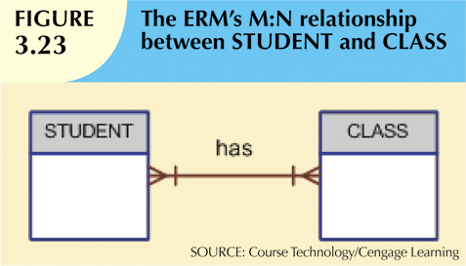

Slide 10
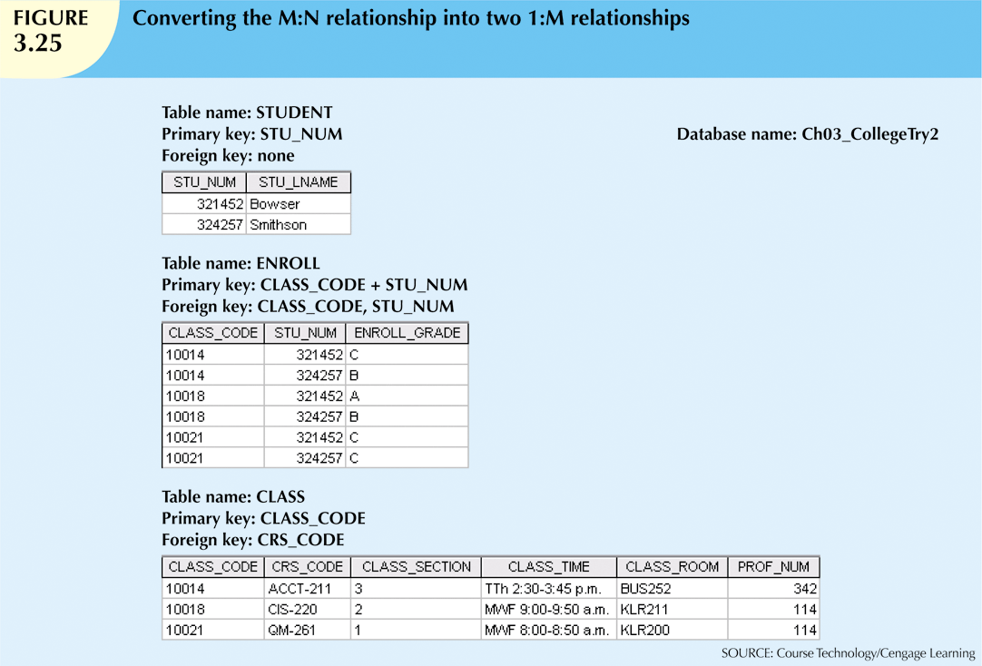

Slide 11


Slide 12
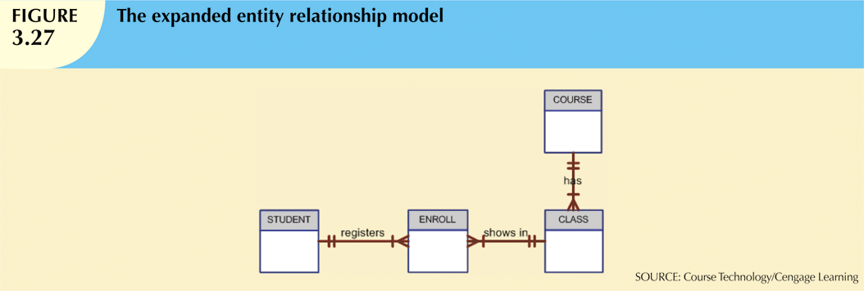

Slide 13
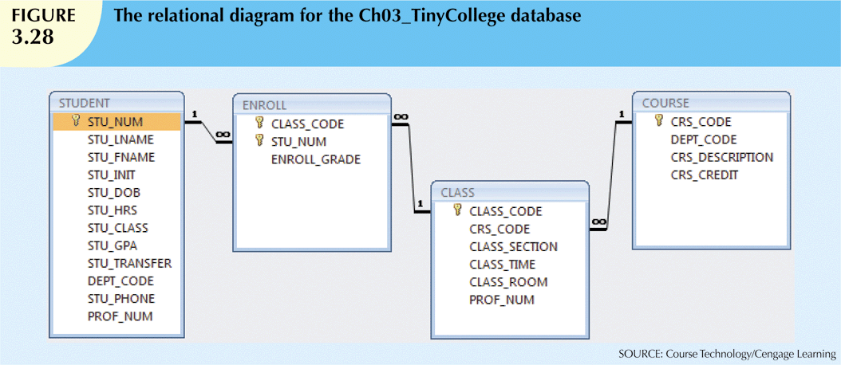

Slide 14
Indexes
Orderly arrangement to logically access rows in a table
Index key
Index’s reference point
Points to data location identified by the key
Unique index
Index in which the index key can have only one pointer value (row) associated with it
Each index is associated with only one table

Slide 15
